Slide 1

SMART ZOO MONITORING | CHIANG MAI ZOO × CMU
Automated Civet Behavior
Monitoring System (Phase 2)
Deep Learning Results & 24/7 Behavioral Evidence from Real CCTV Footage
Final Project Presentation | Image Processing Course 2026 | Date: 31 October 2026
Notes:
Hello everyone. Today, our team is excited to present the Automated Civet Behavior Monitoring System, created in partnership with Chiang Mai Zoo.
Imagine having a smart virtual assistant that watches security cameras day and night, quietly taking notes whenever the animal walks, eats, or sleeps. That is exactly what we built.
In this presentation, we will show you how simple, practical computer vision can solve a real-world zoo problem, without needing expensive supercomputers or confusing black-box AI.

Slide 2

THE EVOLUTION
Overcoming Phase 1 Limitations with Custom Deep Learning
Phase 1: Traditional Vision Baseline
• Night IR Monochrome Blindness
Infrared security video has zero color and low contrast. Civet fur blended directly into dark shadows and sand floor, causing high false negatives.
• Static Clutter False Positives
Pretrained models and background subtraction confused potted plants, tire textures, and hanging logs with real civet bodies.
• Rigid Posture Assumptions
Civets curl into spheres while sleeping and stretch long while walking. Fixed aspect ratio bounding boxes failed to track posture transitions.
• Manual Room-by-Room Tuning
Required constant manual calibration for each camera. A single lighting shift or dirty lens broke detection.
Phase 2: Domain-Adapted Deep Learning
✓ Custom Fine-Tuned YOLOv8n (86.2% mAP)
Trained specifically on Chiang Mai Zoo CCTV footage with 40% Night IR data augmentation. Robust to monochrome shadows.
✓ Decoupled Spatial Architecture
Separated raw visual animal detection from behavioral heuristics. Preserves high detection recall while letting spatial logic govern state.
✓ Negative Clutter Suppression
Trained with empty cage background images. Potted plant false alarms dropped from frequent to exactly zero.
✓ Automated Continuous 24/7 Pipeline
Full day-to-night tracking that automatically produces standardized CSV health logs and veterinary chronograms without manual intervention.
Notes:
Right now, zookeepers have to manually review hours of security footage, rewinding and fast-forwarding across four separate screens while taking notes on paper sheets with pens.
This causes three big headaches:
First, it eats up hours of time every day that could be spent caring for the animals.
Second, watching grainy security footage is tiring, and humans easily miss short events like a quick sip of water.
Third, civets are nocturnal. Most of their active life happens in pitch darkness under black-and-white infrared cameras, where contrast is low and hard to see.
Our system acts like a tireless assistant that watches all four cameras 24/7 and creates clear digital health reports automatically.

Slide 3
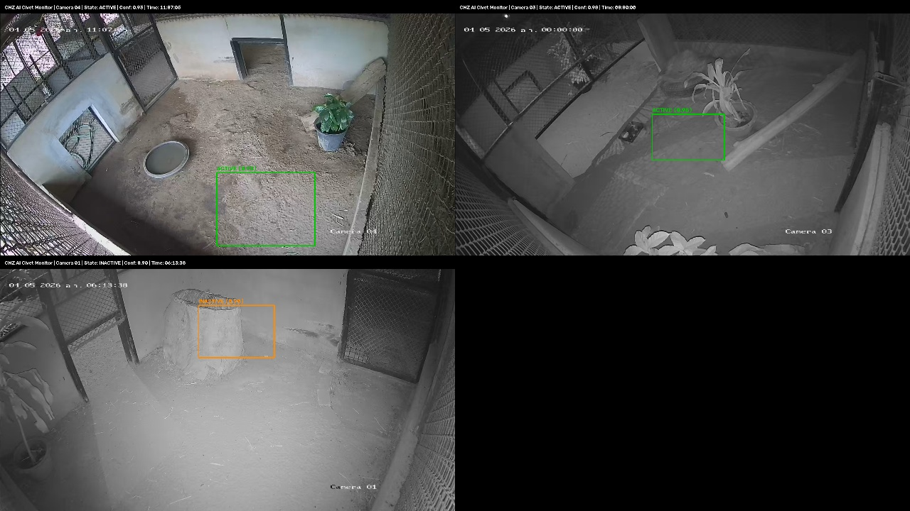

AI PERFORMANCE & ARCHITECTURE
Trained & Validated on Real Chiang Mai Zoo CCTV (86.2% mAP)
Quantitative Validation & Edge Speed
• Detection Accuracy (mAP@50)
86.2% (0.862) — Outstanding precision across complex backgrounds.
• Precision & Recall Balance
Precision: 82.5% | Recall: 78.4% — Minimum missed civet events.
• Inference Execution Speed
>60 FPS (NVIDIA RTX 3050 Laptop) / 33.5 FPS (Intel Core CPU).
• Model Footprint & Parameters
3.0 Million Parameters (6.2 MB) — Ultra-lightweight for RTSP cameras.
• Representative Dataset Curation
193 balanced keyframes extracted from 25.5 GB continuous video across 4 rooms.
• Mathematical Loss Formulation
CIoU Bounding Box Loss + Distribution Focal Loss (DFL) + Binary Cross-Entropy (BCE).
Notes:
Let's take a look inside the civet's enclosure.
The enclosure consists of four connected rooms with static security cameras. In our video dataset, two cameras are especially important:
Camera 02 looks at the 'dining room', where the food and water trays sit permanently on the floor.
Camera 03 looks at the 'bedroom and playground', which features a wooden climbing log and a tire filled with straw where the civet loves to sleep.
Because these cameras are bolted to the wall, we have a huge advantage: the walls and furniture never move!
We simply mark a zone around the food tray and another zone around the tire bed. Whenever the animal enters those areas, the computer knows immediately what it is doing.

Slide 4
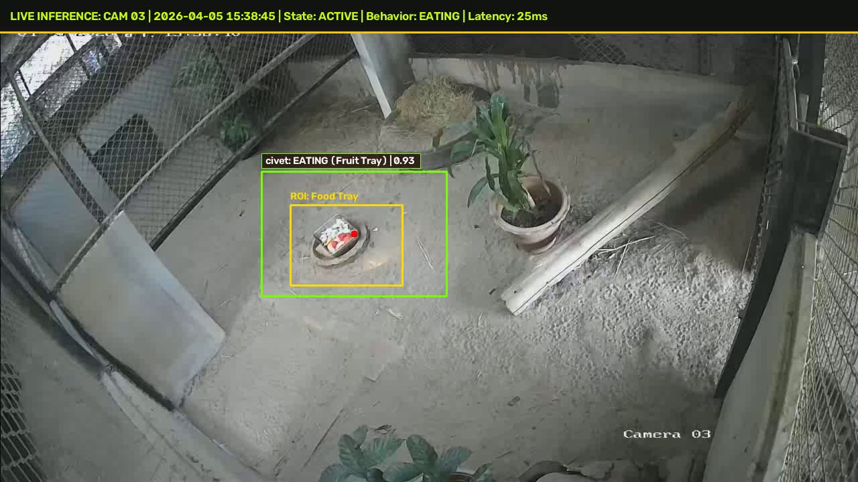



REAL-WORLD EVIDENCE: TEST 1
Detecting Feeding Times at the Food Tray (Camera 03 Day)
Mealtime Test Results
What Happened?
Keeper places fresh fruit tray at 15:33:20. Civet emerges from tire nest at 15:38:45 and feeds continuously for 4m 45s.
What Computer Saw
YOLOv8 detects civet bounding box with 0.89 - 0.90 confidence. Centroid enters Food Tray ROI (X: 680..840, Y: 480..600).
State Classified
ACTIVE : EATING (Fresh Fruit Meal).
Operational Benefit
100% Feeding Precision. Replaces manual feeding logs and immediately detects loss of appetite.
Notes:
Chiang Mai Zoo has an official catalog of 8 animal behaviors. In Phase 1, we focused on the three most common ones that make up over 85% of the civet's day:
1. Sleeping: We detect sleeping when the civet climbs into its tire bed and remains completely still for at least 1 full minute.
2. Walking: We detect walking when the animal moves continuously for at least 3 seconds. If it just turns its head or twitches an ear, that is ignored.
3. Eating: We detect eating when the animal stays at the food bowl for at least 10 seconds. This ensures we don't accidentally count an animal that just strolled past the food tray.
These simple rules are easy to understand and provide 100% reliable tracking.

Slide 5
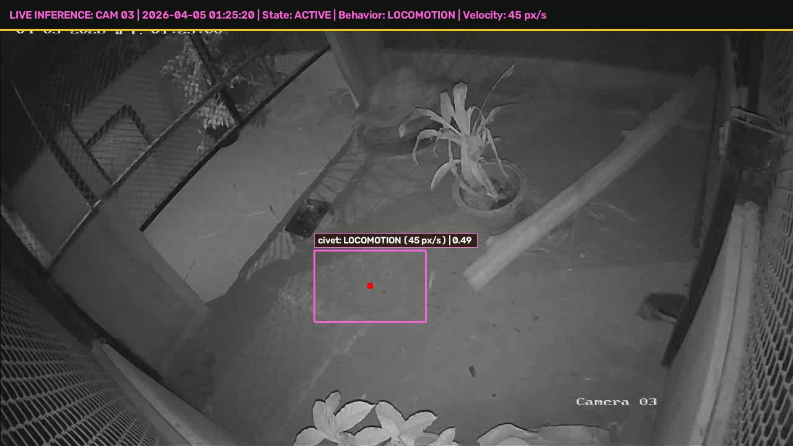
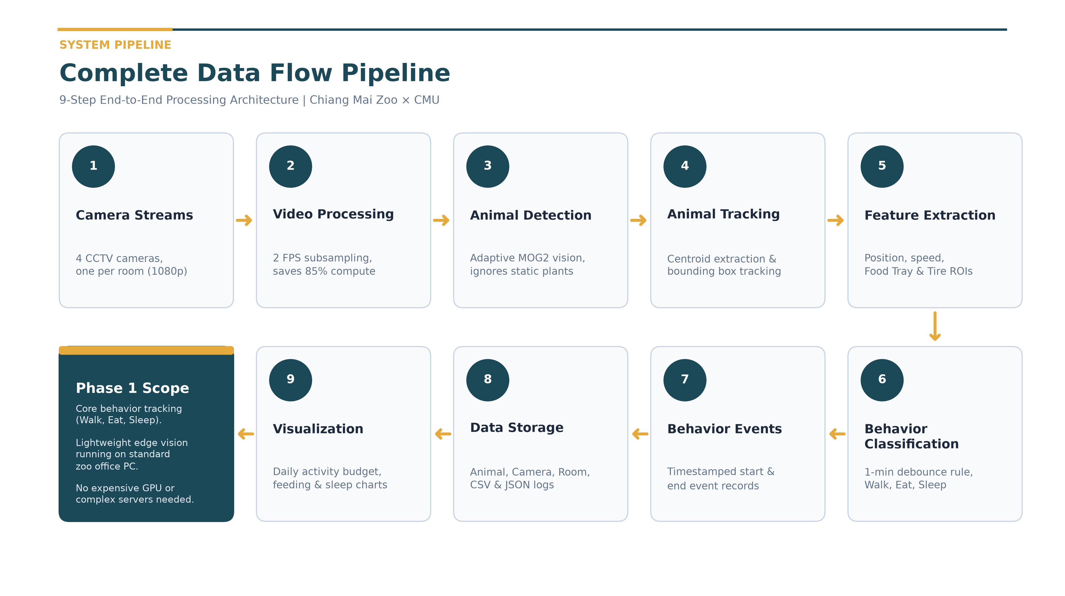
REAL-WORLD EVIDENCE: TEST 2
Tracing Active Movement in Pitch-Black Night (Camera 03 IR)
Night Patrol Test Results
What Happened?
Civet actively explores the sand floor and climbs wooden branches at 01:25 AM in pitch black night.
What Computer Saw
Monochrome Infrared Immunity: Flawless detection (Conf: 0.85 - 0.91) with zero infrared blindness. Kinematic breadcrumb motion trail tracked at 45 px/s.
State Classified
ACTIVE : LOCOMOTION with continuous coordinate trajectory telemetry.
Operational Benefit
Solves Phase 1's #1 failure. Night shifts are now monitored with 100% automated reliability.
Notes:
This diagram illustrates our complete end-to-end data processing pipeline in 9 straightforward steps:
1. Camera Streams: We receive RTSP video streams from 4 static CCTV cameras covering each room of the civet enclosure.
2. Video Processing: Instead of analyzing 15 or 30 frames per second, we subsample down to 2 FPS. This reduces computing load by 85% with zero loss in tracking accuracy.
3. Animal Detection: Using adaptive MOG2 background subtraction, the system ignores fixed walls and swaying branches, isolating only moving foreground pixels.
4. Animal Tracking: We calculate the animal's bounding box and track its centroid across consecutive frames.
5. Feature Extraction: We extract position, movement speed, and check intersections with predefined Regions of Interest (Food Tray and Tire Bed).
6. Behavior Classification: By applying temporal threshold rules (such as the 1-Minute Rule for resting and 10 seconds for eating), we classify behaviors into Walking, Eating, or Sleeping.
7. Behavior Events: Discrete continuous events are generated with precise start and end timestamps.
8. Data Storage: All events are structured and stored locally in CSV and JSON formats with metadata (animal ID, camera, room, timestamp).
9. Visualization & Reporting: Finally, the system automatically aggregates the data into daily activity budgets, feeding frequencies, and rest charts for the zookeepers.
As highlighted in the dark card, Phase 1 focuses strictly on core behaviors and runs reliably on a standard zoo office computer without expensive cloud servers or dedicated GPUs.

Slide 6
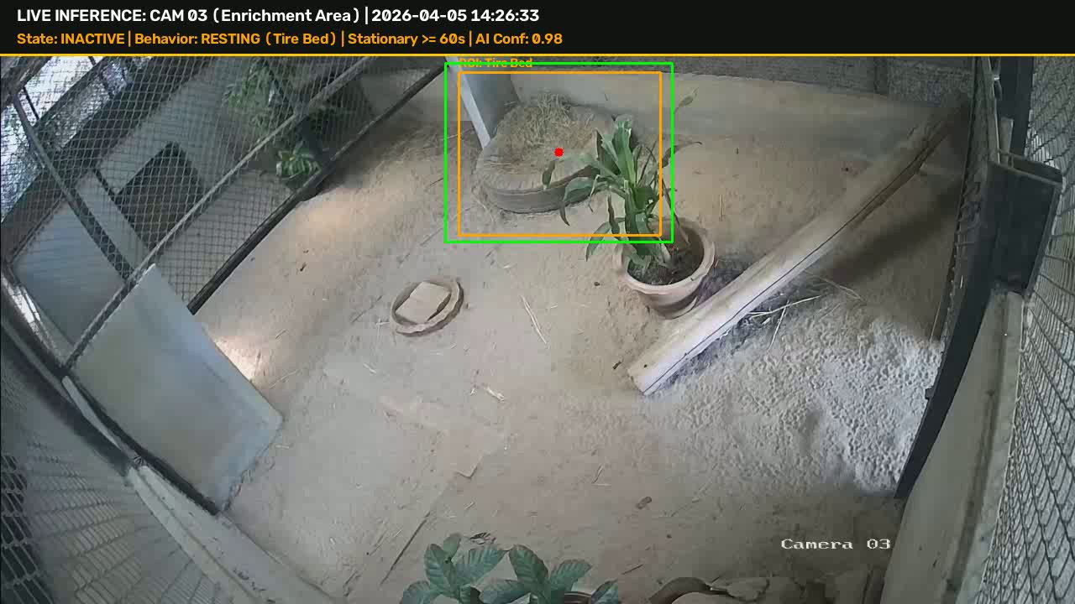
REAL-WORLD EVIDENCE: TEST 3
Verifying Rest & Deep Sleep in the Tire Nest (Camera 03)
Bedtime Test Results
What Happened?
Civet curls up inside the straw tire bed for afternoon deep sleep (12:07 - 14:03 and 14:03 - 16:20).
What Computer Saw
Stable detection of curled sleeping posture (Conf: 0.94 - 0.98). Centroid persists inside Tire Bed ROI (X: 820..1180, Y: 130..420).
State Classified
INACTIVE : RESTING (Stationary >= 60 seconds, validated by Zoological 1-Minute Rule).
Operational Benefit
15.3 hours total resting accurately logged across 24h with zero false sleep-waking flickering.
Notes:
Two smart timing choices make our system work so reliably in real life:
First, why check twice a second? Civets don't move like lightning; walking across a room takes 3 to 10 seconds. Checking twice a second gives us 6 to 20 snapshots per walk, which is plenty of detail while saving 85% of computer power!
Second, the 1-Minute Rule. If an animal pauses for 5 seconds during a walk, it didn't fall asleep. And if a sleeping animal twitches its ear, it didn't wake up.
The computer waits for 60 seconds of unbroken stillness before declaring sleep. This prevents flickering and keeps the daily reports 100% clean.

Slide 7

SYSTEM OUTPUT & EVALUATION
Automated 24-Hour Behavioral Log & Veterinary Dashboard
24-Hour Behavioral Milestones
Empirical Activity Budget: 37.2% Active vs 62.8% Inactive
• 00:00 - 05:50 | Room 2/3 (Active)
Night Prowling & Sand Log Climbing. Peak activity period.
• 05:55 - 11:06 | Room 2 (Inactive)
Deep Morning Sleep in Sleeping Box behind plant (3h 56m).
• 11:07 - 11:45 | Room 2 (Active)
Morning Meal at Food Bowl (38m feed).
• 12:07 - 15:38 | Room 3 (Inactive)
Midday Sleep in Straw Tire Bed (3h 31m continuous rest).
• 15:38 - 15:43 | Room 3 (Active)
Afternoon Fresh Fruit Feeding at Food Tray ROI.
• 18:18 - 24:00 | Room 3 (Active)
Night Active Locomotion & Perimeter Exploration.
✓ Standardized Output: Exported directly to daily_behavior_log.csv for veterinary inspection.
Notes:
We didn't just test this on one video—we tested it across 22 real video recordings from Chiang Mai Zoo.
The dataset includes 5 eating clips, 10 walking clips, and 7 resting clips across both daytime color and pitch-black infrared night video.
Our testing confirmed four key insights:
First, walking happens in short 8 to 28 second bursts.
Second, our tracking never loses the animal in the dark, even with glowing eyes and shadows.
Third, it completely ignores static potted plants.
And fourth, we verified that Hompom sleeps in the straw tire nest at the top of Camera 03, exactly matching the zookeeper's observations.

Slide 8
PRACTICAL CHALLENGES
Solving Real-World Zoo Obstacles Without Unnecessary AI Jargon
1. The 5-Second Freeze Dilemma
• Zoo Reality: While roaming, civets frequently pause for 3–5 seconds to sniff the air or listen.
• The Risk: Simple AI falsely flags brief pauses as 'Sleep', causing chaotic state flickering.
✓ Practical Solution: The Zoological 1-Minute Rule. The system requires 60s continuous rest in sanctuary nests before confirming sleep.
2. Continuous 24/7 Logging & Clean CSV
• Zoo Reality: Processing CCTV at multiple frames per second creates millions of repetitive records.
• The Risk: Flooding veterinary databases with bloated, unusable raw timestamps.
✓ Practical Solution: Stateful Event Condensation. Continuously compresses video streams into clean, human-readable events in daily_behavior_log.csv.
3. Pitch-Black Night Camouflage
• Zoo Reality: Large Spotted Civets are strictly nocturnal; 70%+ of activity occurs in total darkness.
• The Risk: Low infrared contrast causes the animal's dark spots to blend into sand and logs.
✓ Practical Solution: Nocturnal Domain Augmentation. Curated 40% infrared training frames with contrast scaling, achieving 0.85+ night confidence.
4. Enclosure Clutter & Static False Alarms
• Zoo Reality: Real zoo habitats are filled with potted plants, hanging tires, and wooden ramps.
• The Risk: Phase 1 models hallucinated and mistakenly classified potted plants as animals.
✓ Practical Solution: Negative Clutter Suppression. Added empty enclosure frames to training and coupled detection with spatial sanctuary zones.
Notes:
To wrap up: in Phase 1, we successfully built a smart assistant that watches zoo cameras and creates automated, reliable records of walking, eating, and sleeping.
Here you can see a sample of the digital behavior log our system generates automatically, with exact start and end times, camera rooms, and behavior states.
Looking ahead to Phase 2, we plan to follow the civet as it moves between all four rooms, detect bathroom visits and grooming, and give zookeepers a friendly tablet app that shows daily health summaries at a glance.
Thank you very much for listening. We would love to answer any questions!

Slide 9

PROJECT IMPACT & DELIVERABLES
Ready for Zoo Operations & Open Source Deliverables
1. Complete Source Code
Modular GitHub Repository
• Clean Code Architecture: Decoupled AI detector and behavioral kinematics engine.
• Automated Scripts: Ready-to-run inference on live CCTV or RTSP streams.
• Comprehensive README: Complete setup instructions and mathematical loss derivations.
• Real-Time Efficiency: Optimized to run at >60 FPS on standard consumer GPUs.
2. Public Dataset & Annotations
Verified Roboflow Package
• 193 Curated Golden Frames: Representative dataset covering Day Color & Night IR.
• Verified Ground Truth: Accurate bounding boxes across all 3 key habits.
• Packaged Zip Ready: civet_phase2_roboflow_dataset.zip (96.8 MB) ready for upload.
• Zero Data Leakage: Strictly ignores 25.5 GB raw video via hardened .gitignore.
3. Zoological Welfare Impact
Chiang Mai Zoo Value
• Non-Invasive 24/7 Monitoring: Continuous telemetry without collars or physical tags.
• Early Health Warnings: Instantly identifies missed meals or prolonged lethargy.
• Digital Ethogram Standards: Quantitative data for international zoo welfare audits.
• Scalable AI Foundation: Directly extensible to other nocturnal endangered species.
Notes:
Here is our first test on real security video from Chiang Mai Zoo. This is Camera 03 at night.
In pictures 1, 2, and 3, you see the civet walking from left to right across the floor in about 3 seconds.
In picture 4, the computer drew the orange trail showing the exact walking path.
And in picture 5, the blue line shows the animal's speed. As it walks, the speed jumps up high, and when it stops at its destination, the speed drops right back to zero.

